Slide 1
Car price prediction
By
VANISREE P.G

Slide 2
ACKNOWLEDGMENT
First I would like to thank the Almighty for his wonderful presence with me throughout this project and helped me to make it as a successful one. For my internship I had the pleasure of working at FILP ROBO Was a great chance for acquired knowledge, personal and Professional development. I extend whole hearted thanks to FILP ROBO under whom I worked and learned a lot and for enlightening me with their knowledge and experience to grow with the corporate working
This is a great pleasure to express my deep sense of gratitude and thanks to SME for his valuable ideas, instantaneous help, effective support and continued encouragement which enabled for the successful completion of the project. I also like to thank the data trained mentors and Technical team members for helping me with technical queries.
These are the following website which I referred for the references.
https://scikit-learn.org/
https://kaggle.com
www.google.com
www.geeksforgeeks.org

Slide 3
Business Problem Framing
A car price prediction has been a high interest research area, as it requires noticeable effort and knowledge of the field expert.
Considerable number of distinct attributes are examined for the reliable and accurate prediction.
With the covid 19 impact in the market, we have seen lot of changes in the car market.
Now some cars are in demand hence making them costly and some are not in demand hence cheaper. One of our clients works with small traders, who sell used cars. With the change in market due to covid 19 impact, our client is facing problems with their previous car price valuation machine learning models.
So, they are looking for new machine learning models from new data. We have to make car price valuation model.

Slide 4
Motivation for the Problem Undertaken
To understand real world problems where Machine Learning and Data Analysis can be applied to help to predict the prices in various domains to make better decisions with the help of which they can gain profit or can be escaped from any loss which otherwise could be possible without the study of data
Accurate car price prediction involves expert knowledge, because price usually depends on many distinctive features and factors. Typically, most significant ones are brand and model, age, horsepower and mileage.
The fuel type used in the car as well as fuel consumption per mile highly affect price of a car due to a frequent changes in the price of a fuel.
Different features like exterior color, door number, type of transmission, dimensions, safety, air condition, interior, whether it has navigation or not will also influence the car price.

Slide 5
Data Sources
Data is collected from a local web portal for selling and buying cars .
The data is scraped from the cars24 website The data descriptions are as follow:- (5521, 11) rows and columns.
To predict car prices using Regression.
With the help of Pandas Library We will upload our data to Jupyter Notebook.
Once our Data is Scraped from the cars 24 website and used.
We have two type of variables in the data:-
Dependent Variable
Independent Variable
I will start by importing all the necessary libraries that we need for this task and import the dataset.
1) Importing libraries
2) Importing the dataset

Slide 6
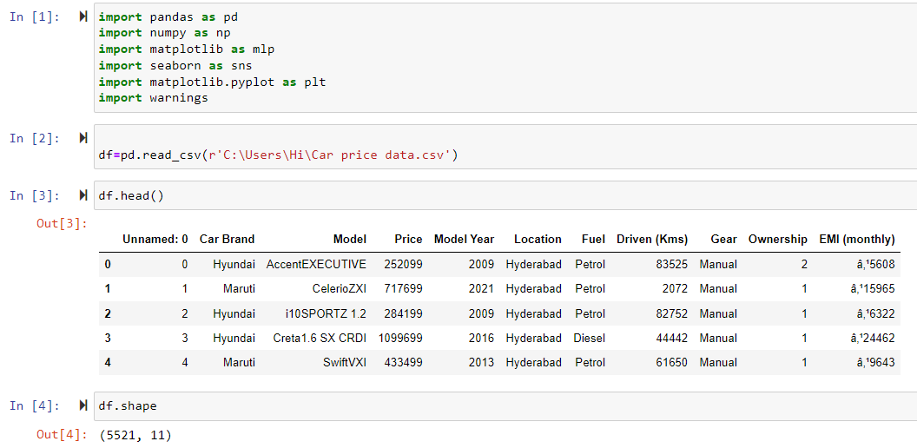
Data file

Slide 7
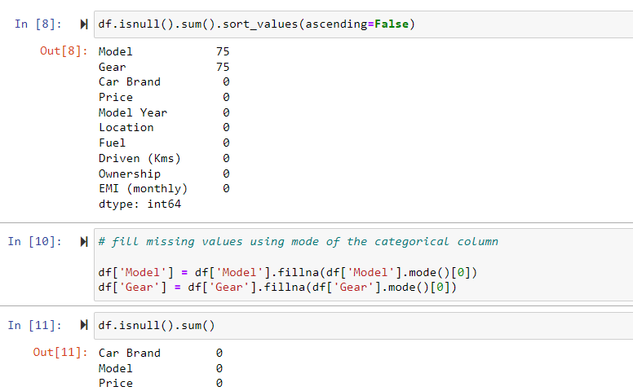
There were null value was present in the dataset but there are some outliers which also get to removed.
We drop large number of missing value columns. some other columns have null values these are Filled by mode.

Slide 8
Data Pre-processing Done
The raw data is taken and performed various steps to reduce skewness, outlier, class imbalance and scaling. There were null value was present and removed the values from the dataset. Many outlier removal and skewness removal methods are tested and best method Is chosen in order to prevent data loss.
· The dataset contains 5521 rows and 11 columns
· Price is our dependent variable.
· We created new features from old ones.
· There are no null values in the dataset.
· Removed empty cells

Slide 9
Data Inputs- Logic- Output Relationships
The input data contains 5521 rows and 11 columns.
Predictor variable are
Car Brand, Model , Model Year, Location, Fuel, Driven (Kms), Gear, Ownership, EMI (monthly).
Target variable is Price of the car

Slide 10
HARDWARE AND SOFTWARE REQUIREMENTS AND TOOLS USED
Hardware used for doing the project is a ‘Laptop’ with high end specification and stable internet connection .while coming to the software part I had used ‘python jupyter notebook’ for do my python program and data analysis.
Excel file and Microsoft excel are required for the data handling. In jupyter notebook I had imported lot of python libraries are carried to this project and I have mentioned below detailed.
1.Pandas-a library which is used to read the data ,visualization and analysis of data.
2.Numpy-used for working with array and various mathematical operations in python.
3.Seaborn- visualization for plotting different type of plot.
4.Matplotlib- It provides an object-oriented API for embedding plots into applications
5.Selenium- to scrape the data

Slide 11
MODELS USED
Regression Model with following algorithms
Linear Regression
DecisionTreeRegressor
Random forest regressor
Gradient Boosting Regressor
Ridge
Evaluation metrics
Mean square error
Mean absolute error
R2 score
Root Mean Squared Error

Slide 12
Testing of Identified Approaches (Algorithms)
Listing down all the algorithms used for the training and testing.
LR=LinearRegression()
DT=DecisionTreeRegressor()
GBR=GradientBoostingRegressor()
rf=RandomForestRegressor()
R=Ridge()

Slide 13
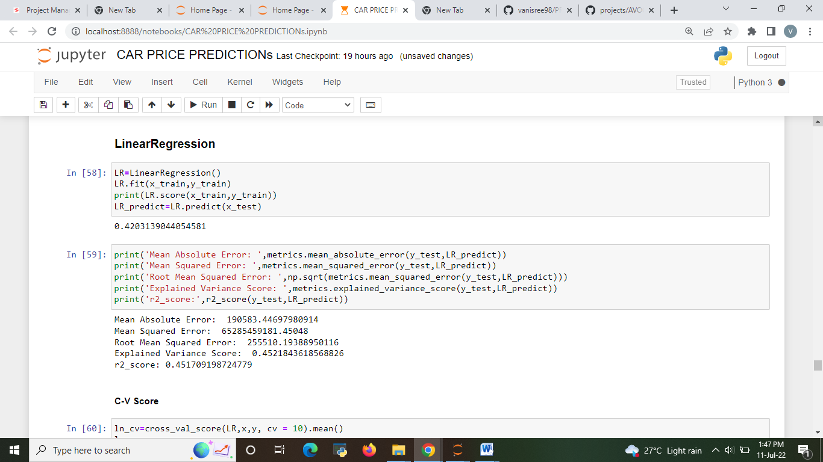
Run and Evaluate selected models 1.Linear Regressor
Describe all the algorithms used along with the snapshot of their code and what were the results observed over different evaluation metrics.

Slide 14
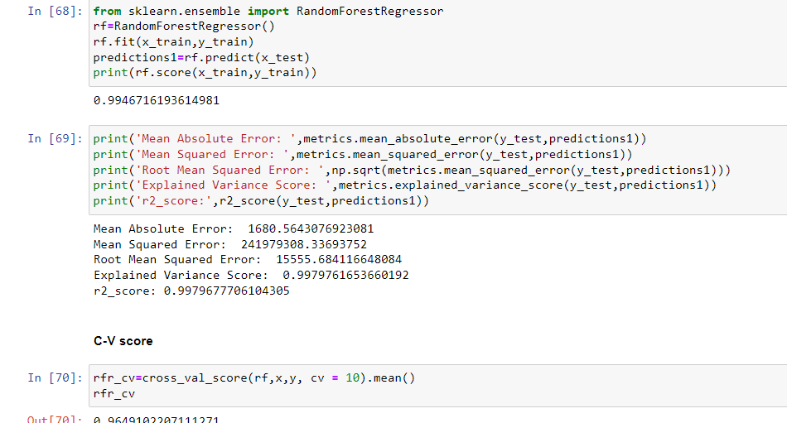
2.Random Forest Regressor

Slide 15
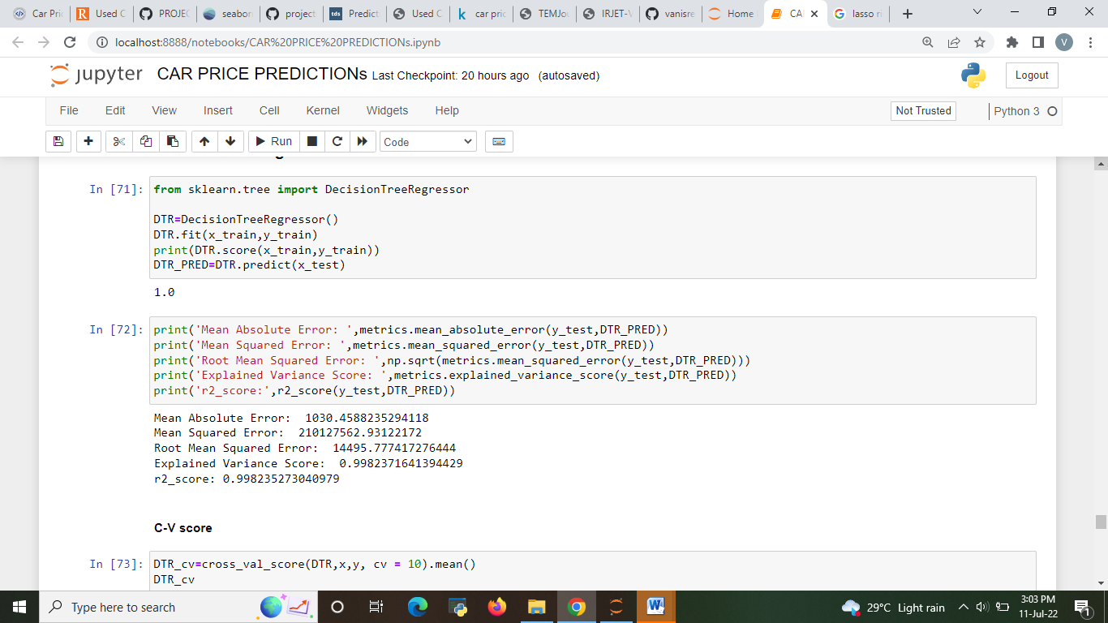
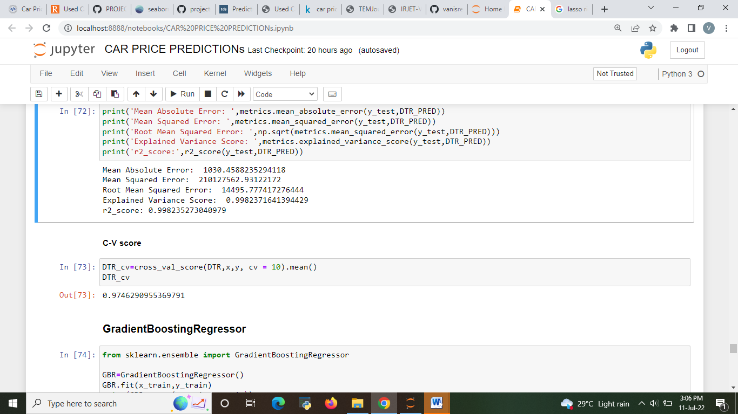
3. Decision Tree

Slide 16
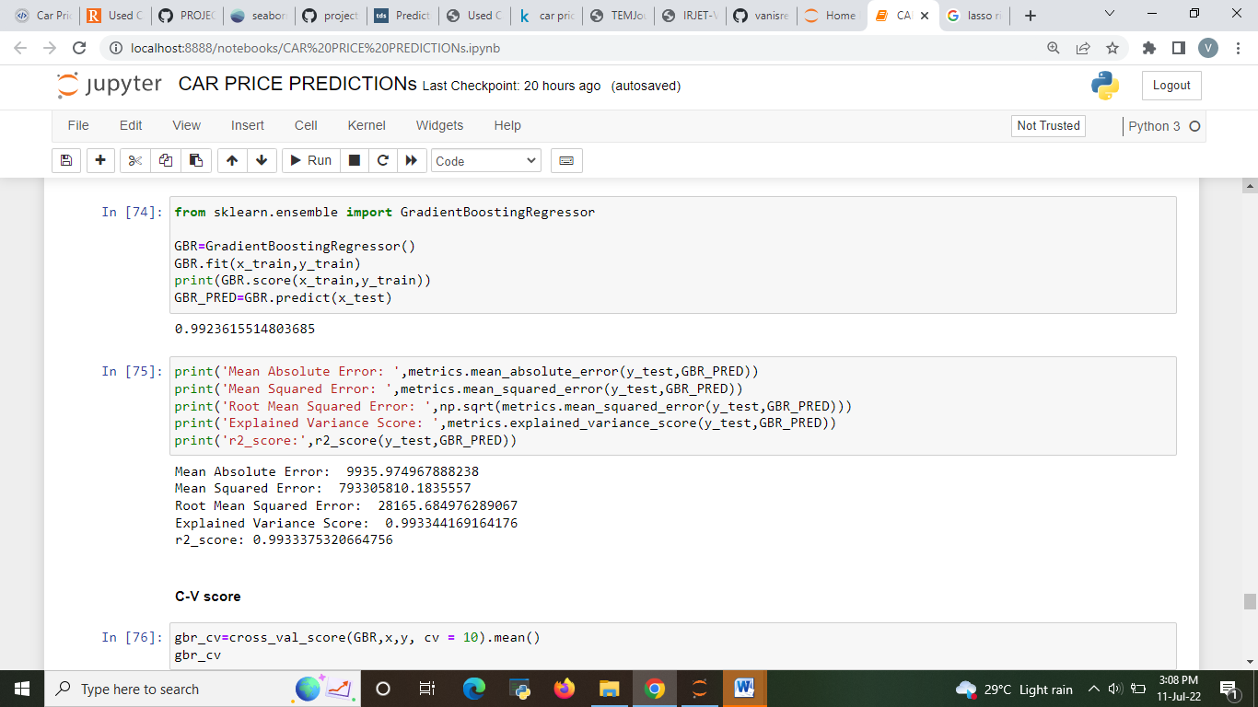
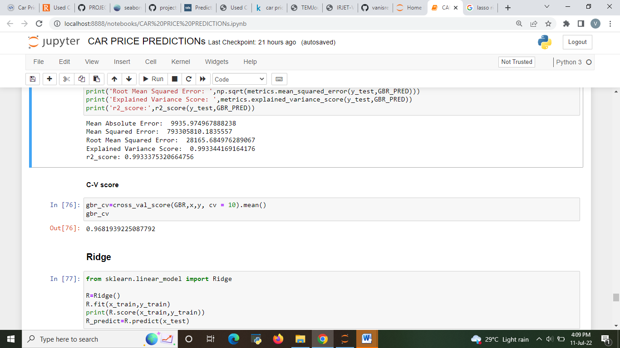
4.GradientBoostingRegressor

Slide 17
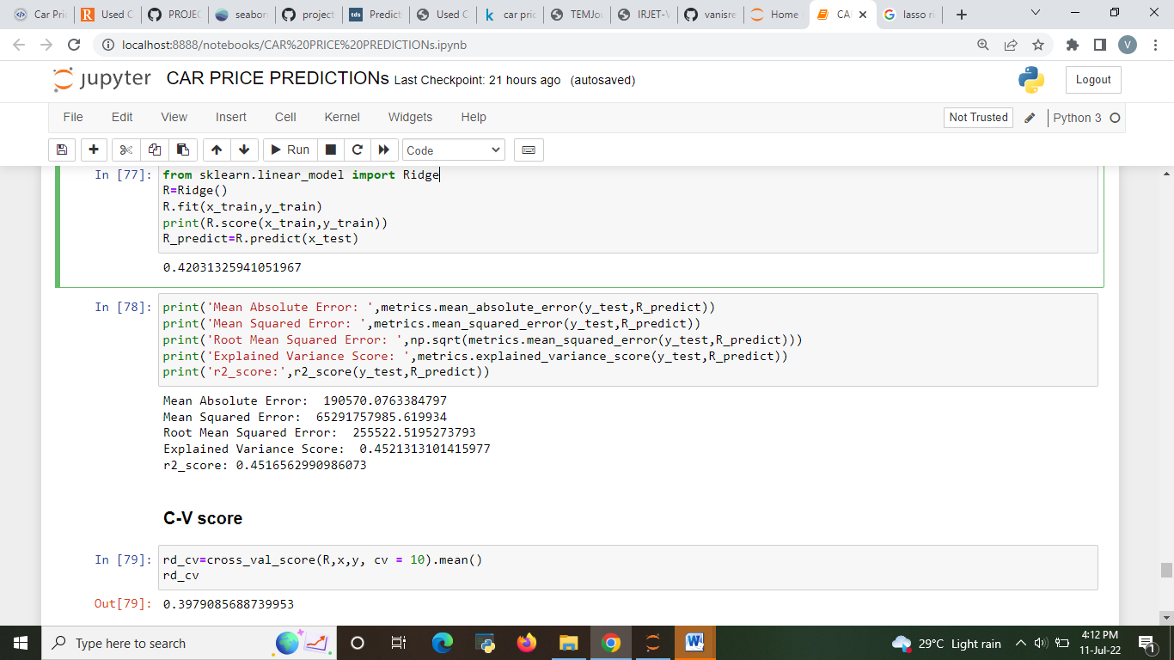
5.Ridge regression

Slide 18
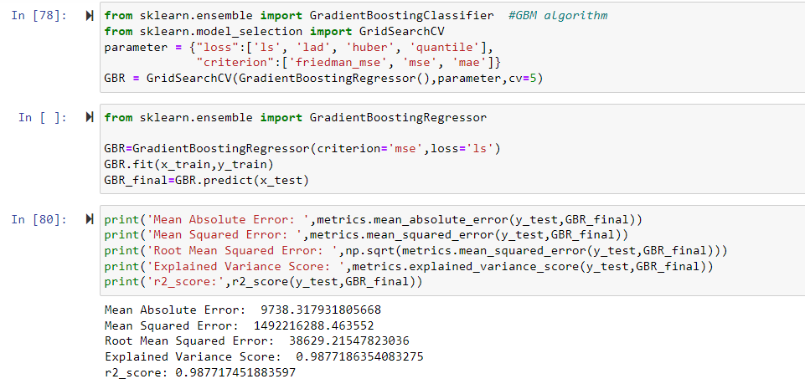
Hyper parameter tuning 1.GradientBoostingRegressor

Slide 19
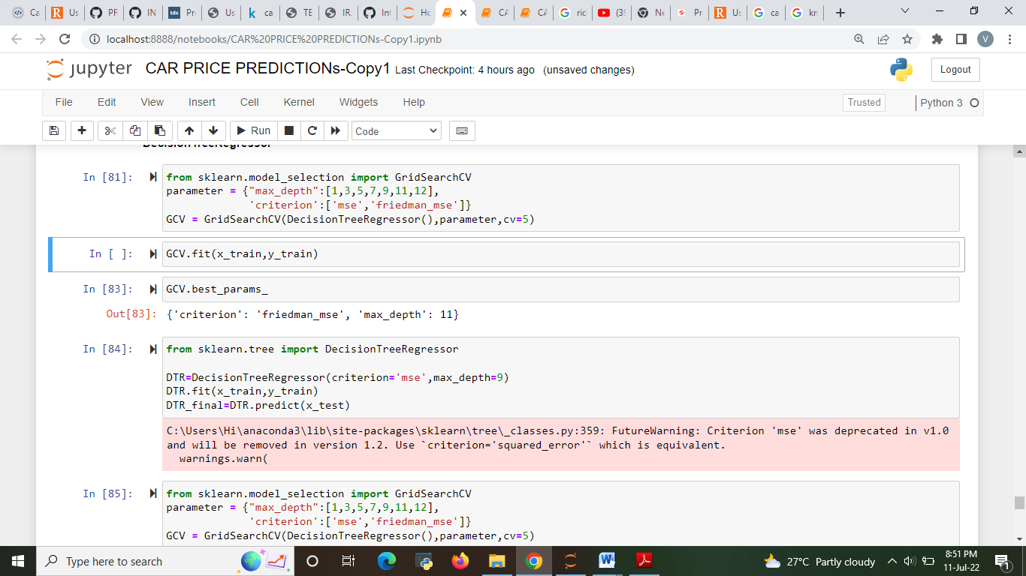
2.DecisionTreeRegressor

Slide 20
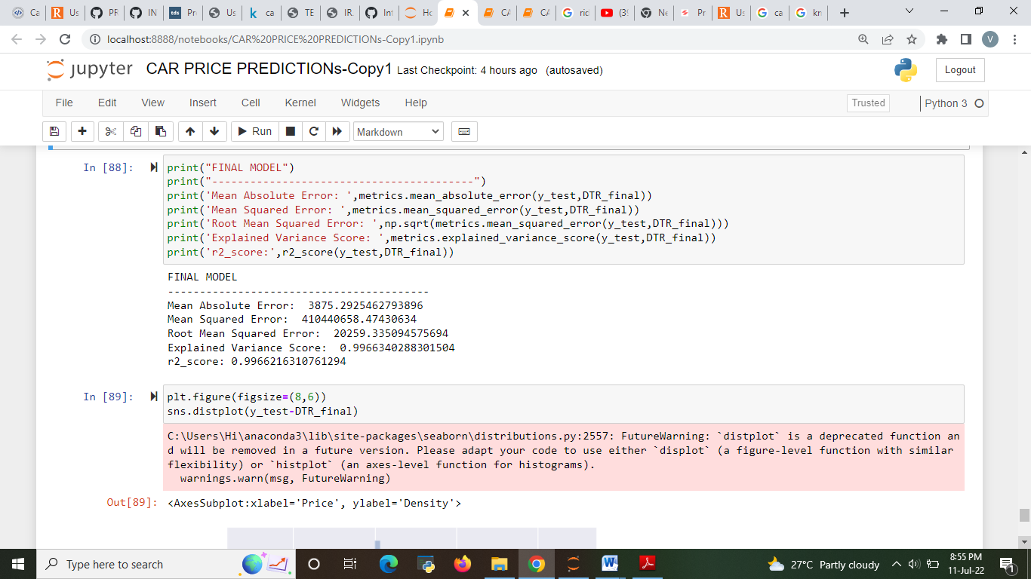
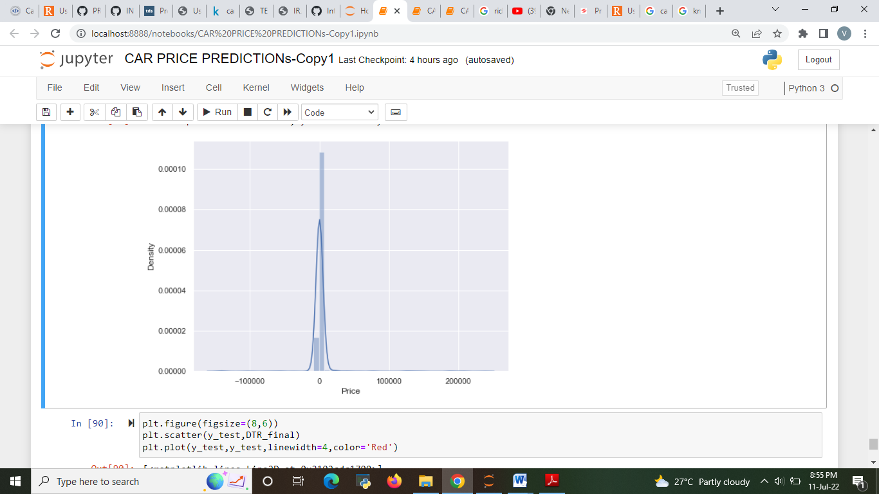
FINAL MODEL
The best model after hyper parameter tuning is DecisionTreeRegressor

Slide 21
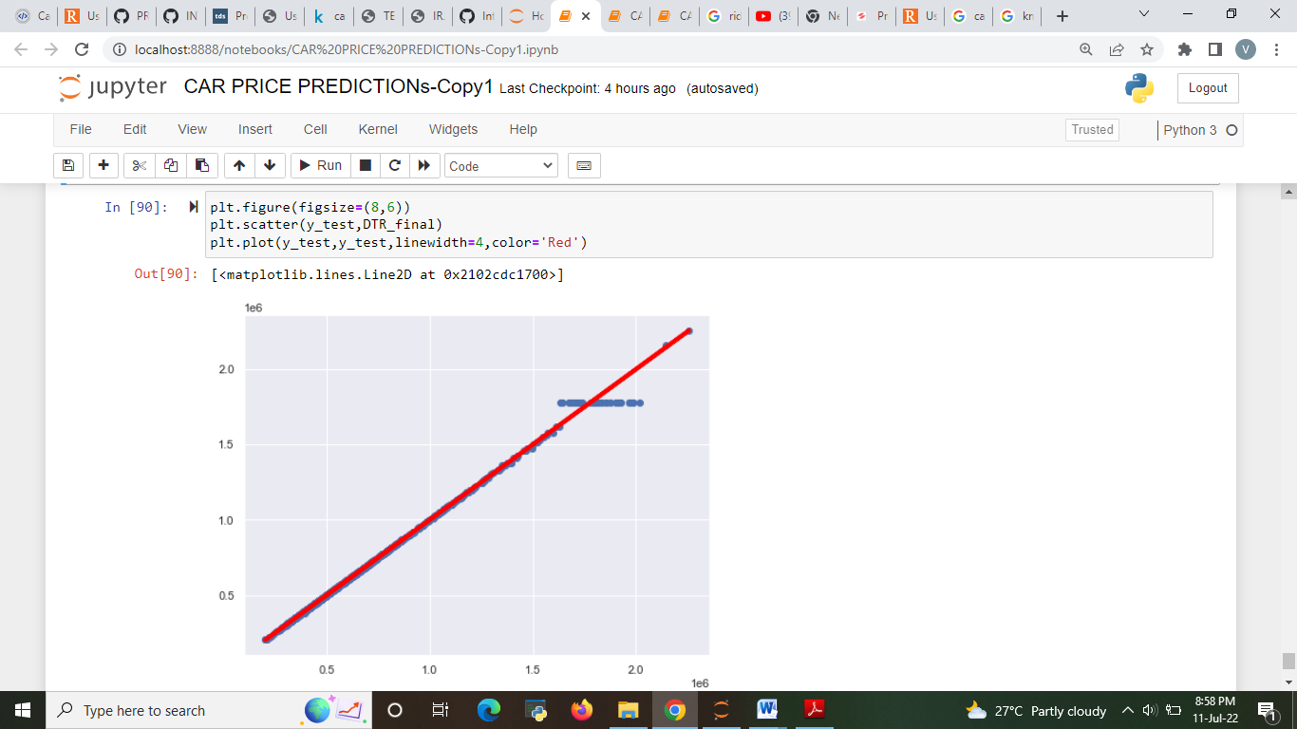

Slide 22
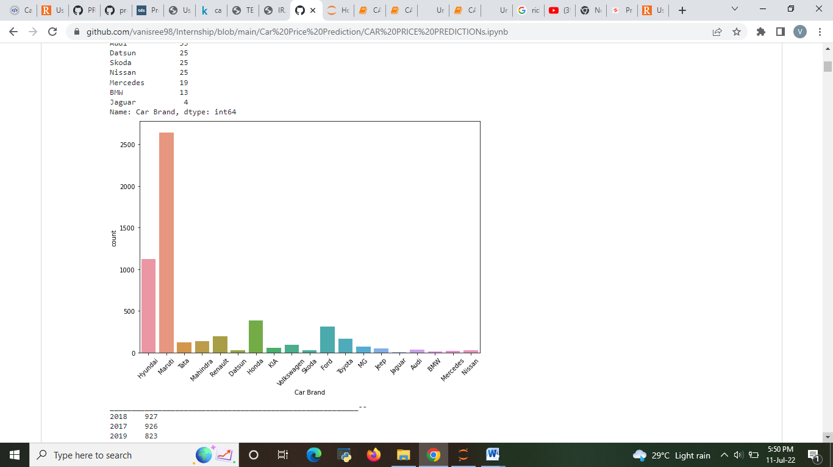
Visualizations
Maruti and Hyundai are the highest demanding car brand. BMW and Jaguar are the lowest demanding car brand.

Slide 23
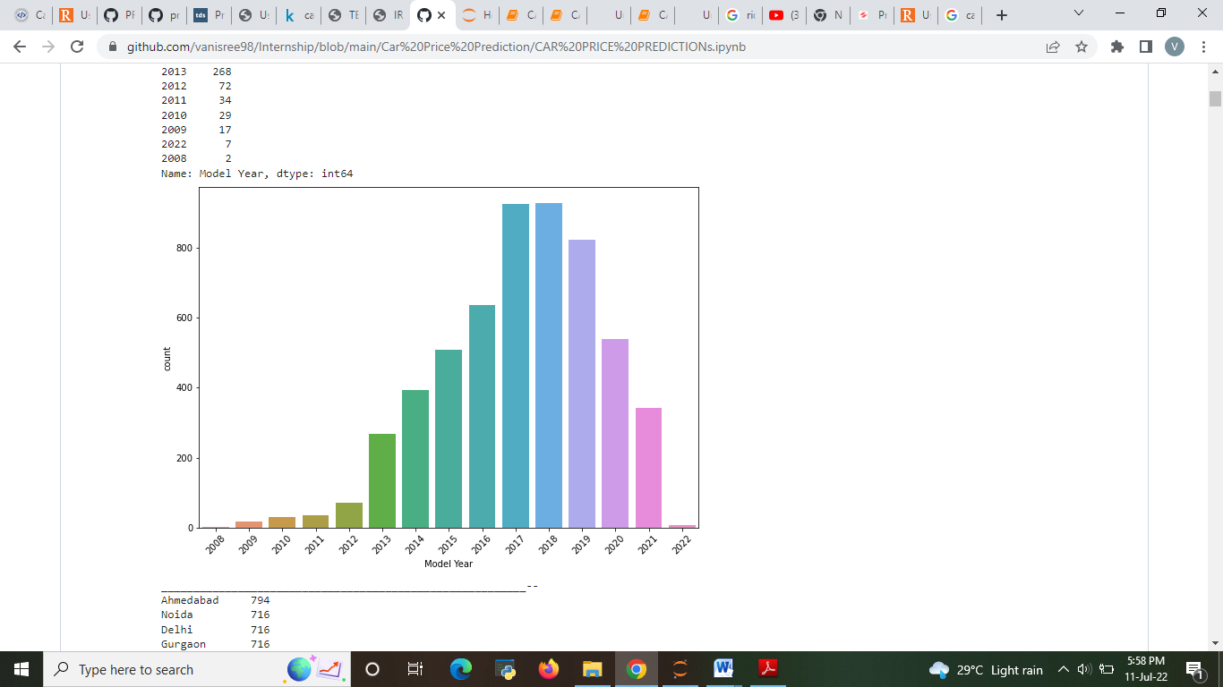
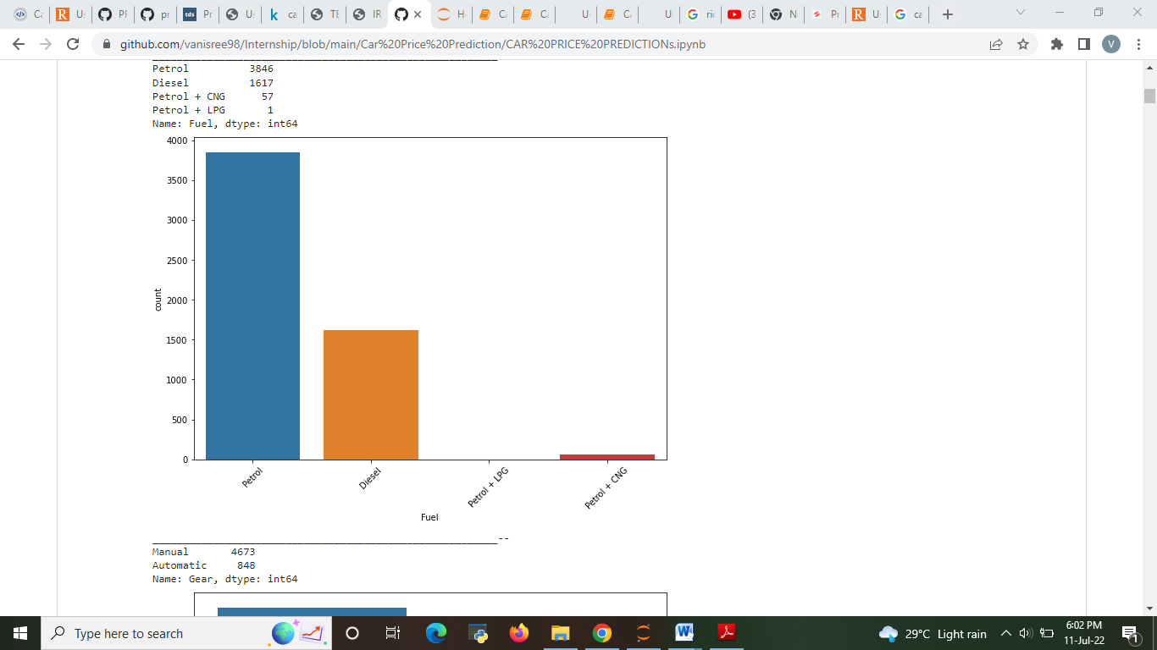
2017,2018 and 2019 model year car have most wanted by customers.
Petrol and Diesel cars are high demand for customers.

Slide 24
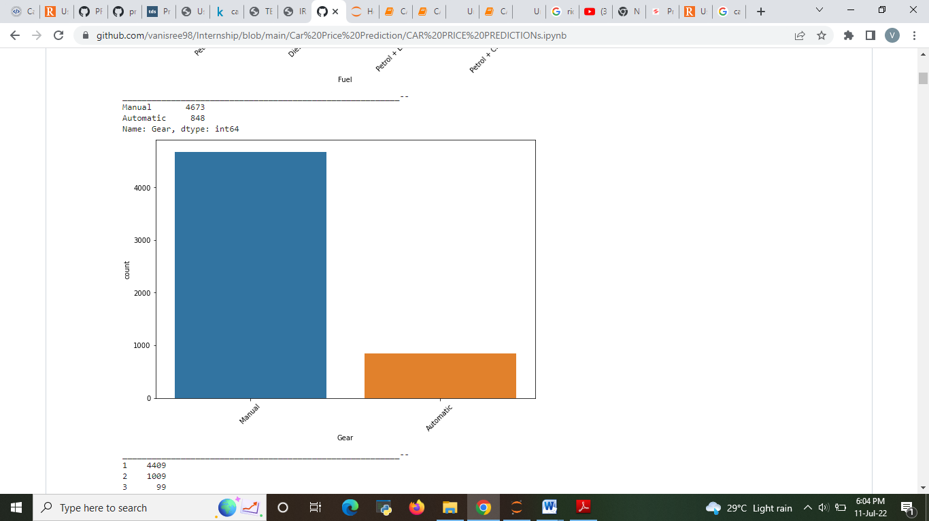
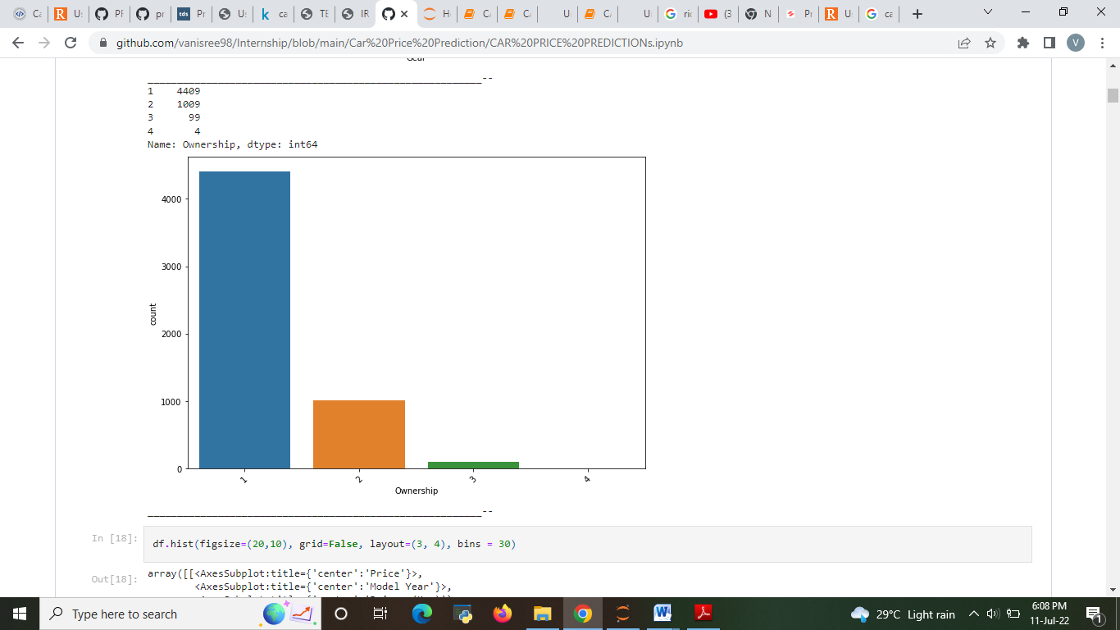
Manual gear type cars are the most demanding by customers.
Plot show ownership of the car.

Slide 25
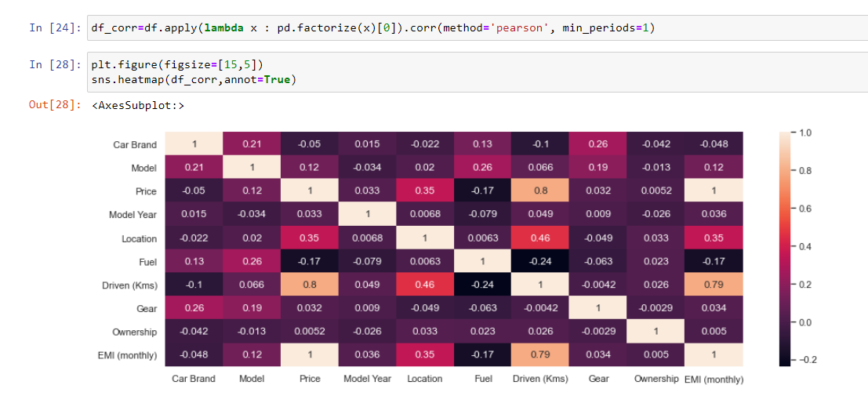
CORRELATION
1.Driven(kms) has 80 percent correlation with target column which can be considered as a good bond.
2.Location has 35 percent correlation with target column which can be considered as a good bond.
3.Model since the has 12 percent correlation with target column which can be
considered as a good bond.

Slide 26
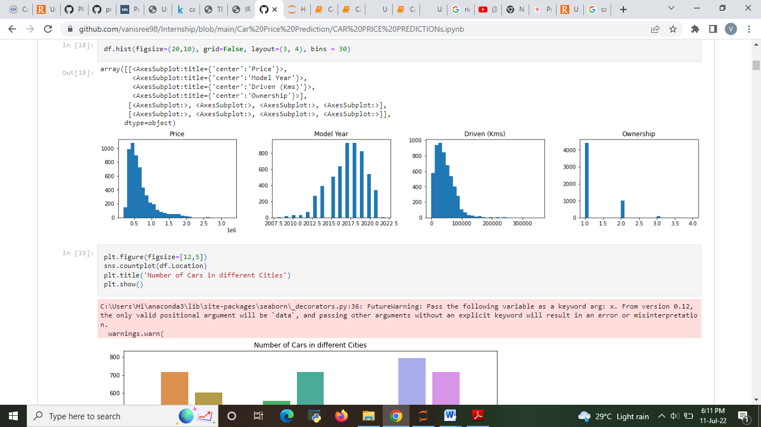
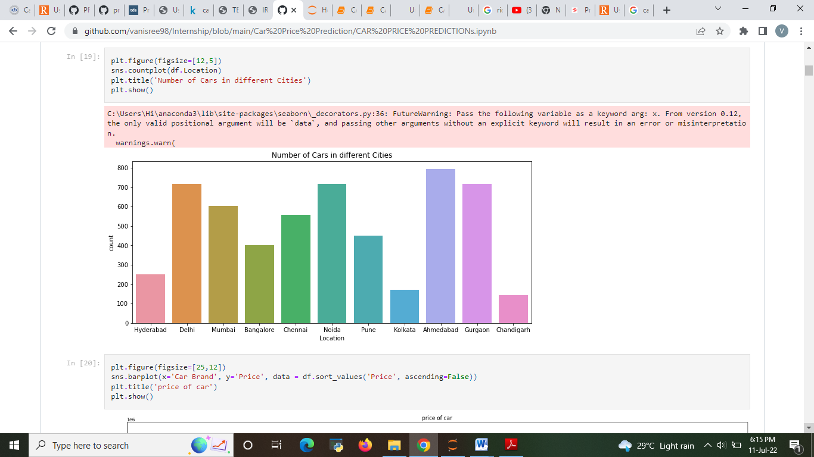

Slide 27
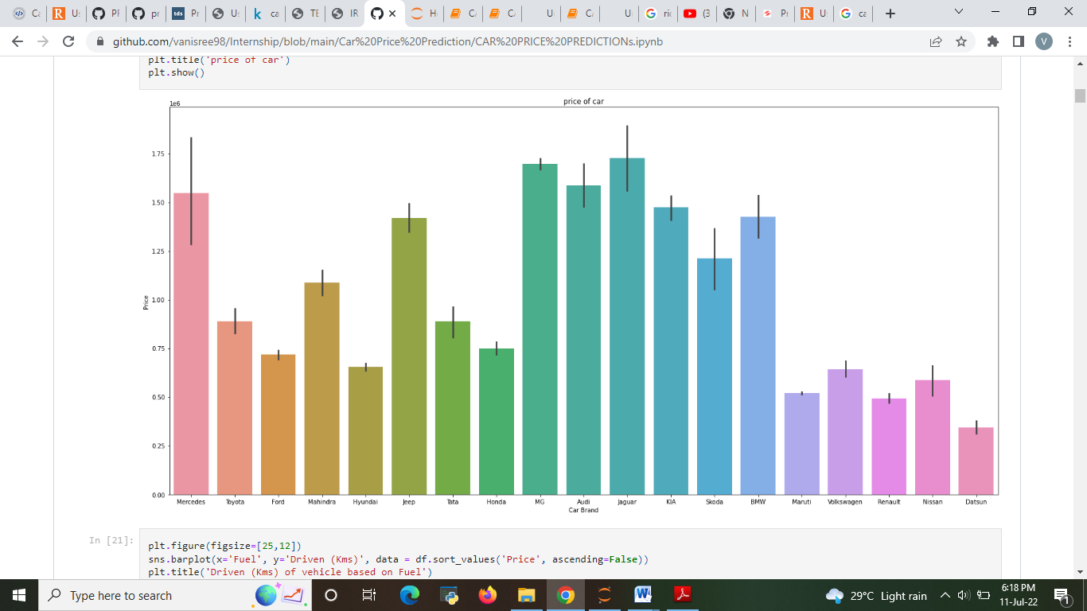
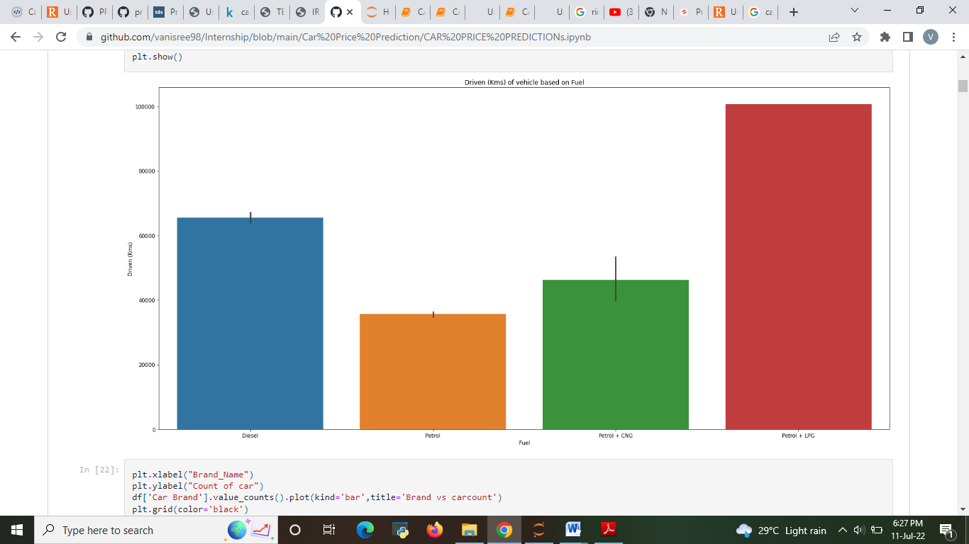
MG, Jaguar, Audi and Mercedes car brand have highest price compare with others cars.
Petrol+LPG has the Average Car Last.

Slide 28
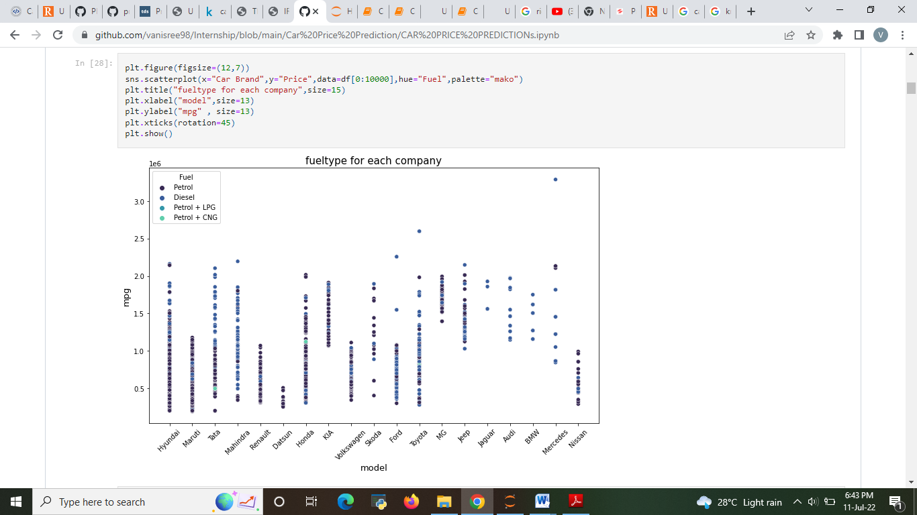

Slide 29
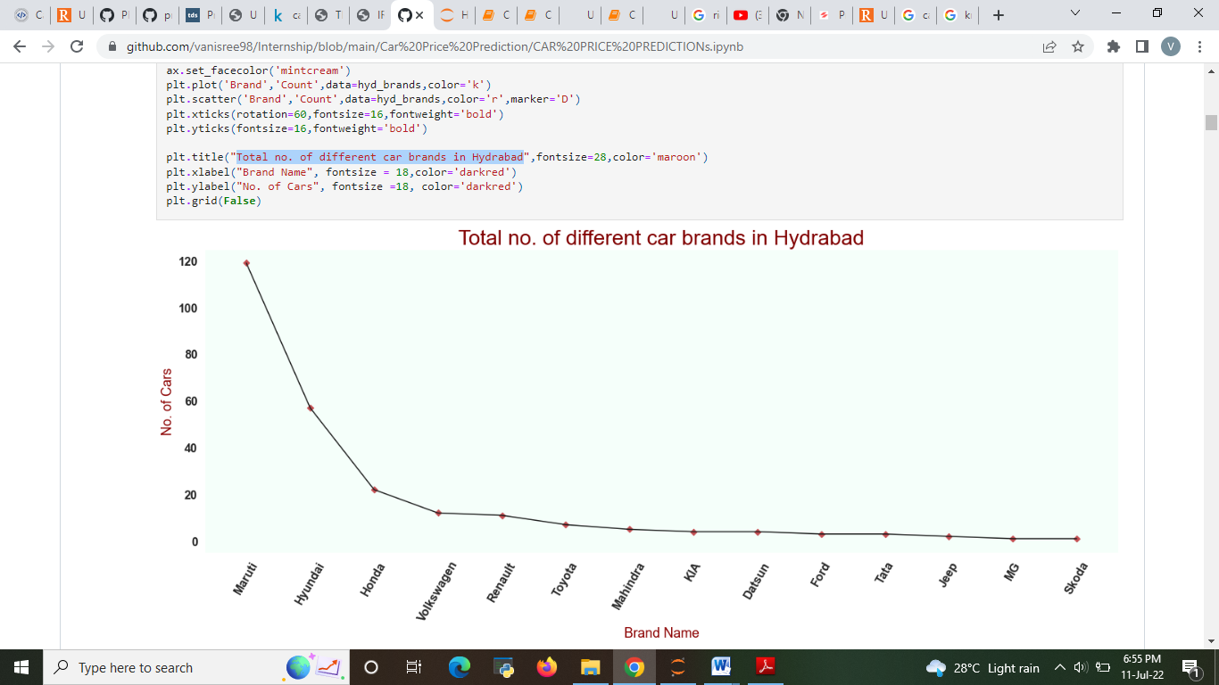
Total no. of different car brands in Hyderabad.

Slide 30
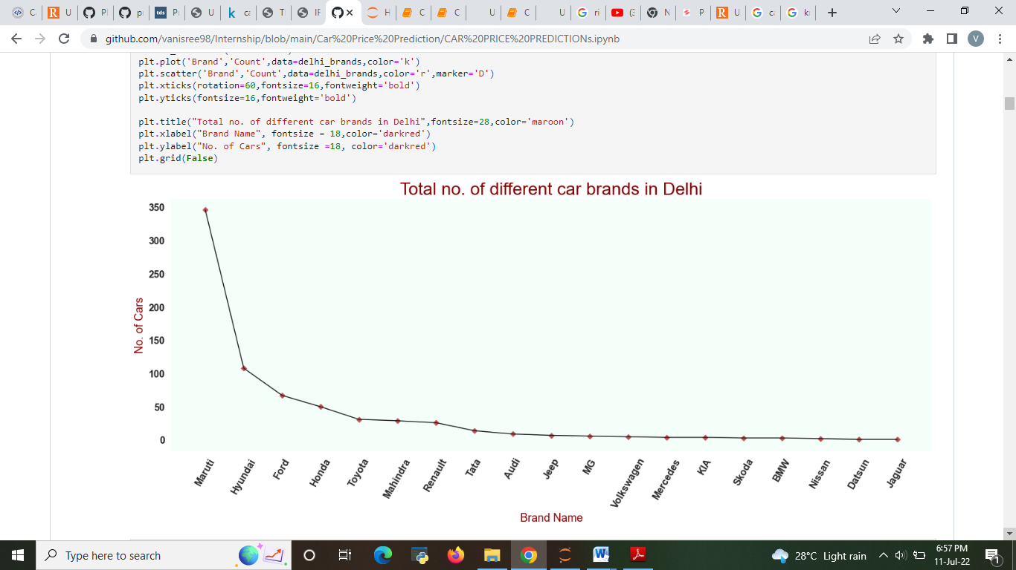

Slide 31


Slide 32


Slide 33


Slide 34


Slide 35


Slide 36


Slide 37


Slide 38


Slide 39
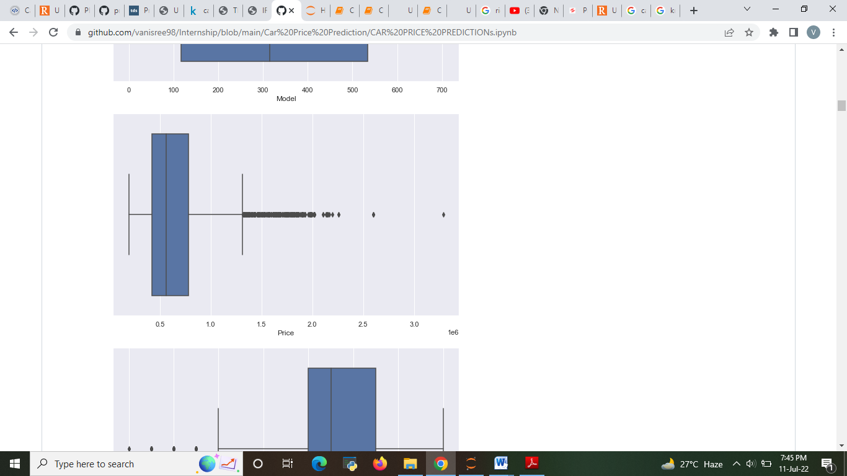
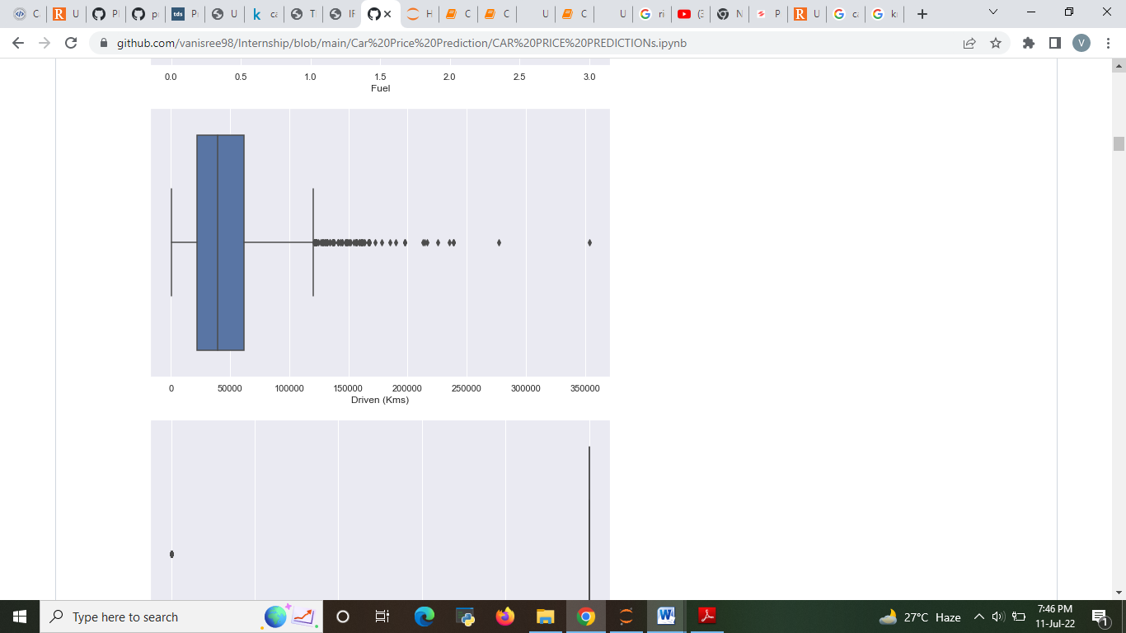
Checking the outliers

Slide 40
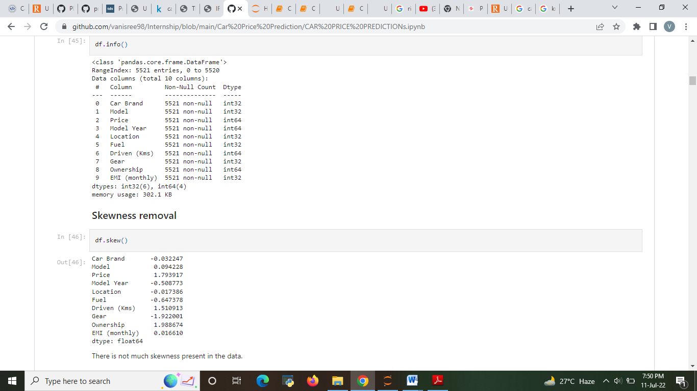
Skewness removal

Slide 41
Observations
BalenoDELTA 1.2 K12 car model is a most demand among the customers
MG, Jaguar, Audi and Mercedes car brand have highest price compare with others cars.
'Driven (Kms) of vehicle based on Fuel Petrol + LPG has high demand.
Compare petrol ,diesel cars has more count among all cities.
Compared to other 4 cities 'Hyderabad'(415+) has less available cars.
'Maruti' brand cars are widely available with a count of around 2800 cars in all the cities, followed by Hyundai(1240+), Honda(449), Toyota(280+)
Most of the cars runs with 'Petrol' with a count of 3663.
High budget car among all cities:
Toyota Land CruiserLC200 VX 2 PREMIUM (3495000/-), 2010 Model, available in Mumbai
Low budget car among all cities:
Maruti AltoLX (91000/-), 2008 Model, available in Delhi

Slide 42
RESULT
Totally 5 models are performed
Linear regression
Decision tree regressor
Random forest regressor
Gradient Boosting Regressor
Ridge
Among that models Decision tree regressor model is chosen as a best model

Slide 43
Conclusion
I check the data first scraped and uploaded the data in jupyter notebook and than I visualize the features ,Perform the preprocessing in the data and understand the relationship between different features.
I used both train-validation split and the cross validation to evaluate the model effectiveness to predict the target values.
At the end I applied the 4 predictive models in the data.
Then after performing all the model the best model is chosen as linear regression .

Slide 44
Limitations and Scope
The techniques to increase the speed of the model need to be constructed.
The future model can be constructed with the most co related data with the target variable in order to increase the speed of the model.
In future this machine learning model may bind with various website which can provide real time data for price prediction.
Also we may add large historical data of car price which can help to improve accuracy of the machine learning model.
We can build an android app as user interface for interacting with user.

Slide 45
THANK YOU

